Slide 1

Predicting Colorado Wildfires
Jordan Burns

Slide 2
Introduction
Objective
Data Sources
Initial Exploratory Data Analysis
Combining the Data Sets
Logistic Regression Analysis
Decision Tree Analysis
Conclusion

Slide 3
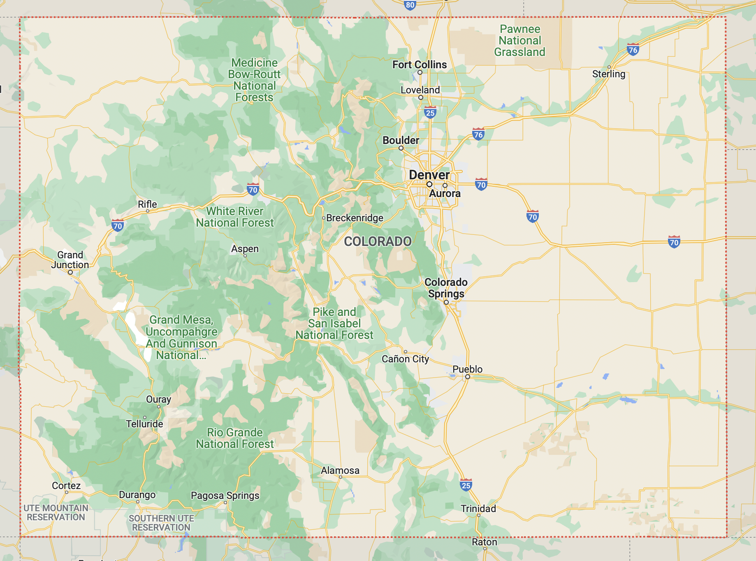
Objective
Analyze various weather parameters to determine any correlation between weather patterns and wildfire occurrences
Create models that could be used to predict future wildfire occurrences in the state of Colorado

Slide 4
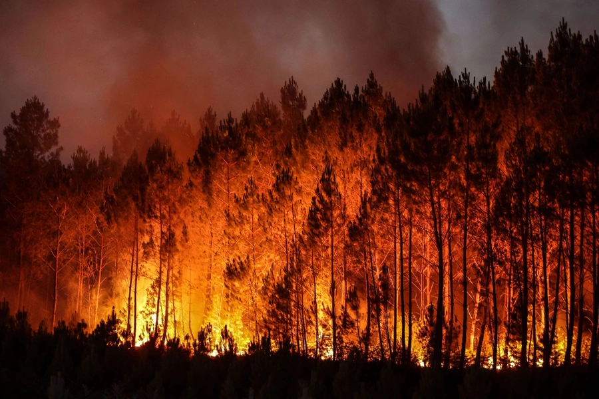
Data Sources
Two data sources used for the analysis:
U.S. Wildfire Data
Colorado Weather Station Data
Wildfire data set is used to determine location and time; weather data set is used to match these locations/times to weather observations

Slide 5
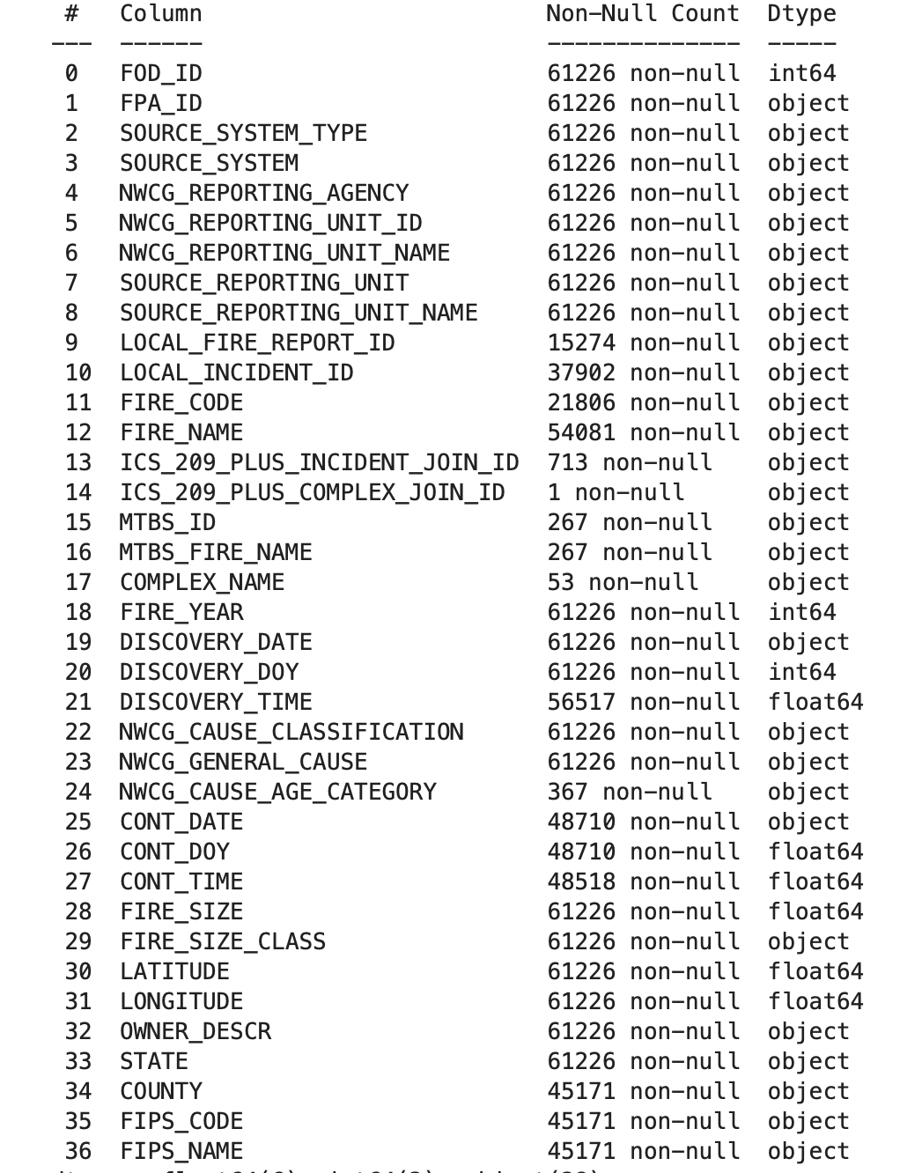
Data Sources (cont.)
U.S. Wildfire Dataset
Contains 24 years of Wildfire occurrences
Including location, size, discovery time, etc.
Source: https://www.kaggle.com/datasets/rtatman/188-million-us-wildfires

Slide 6
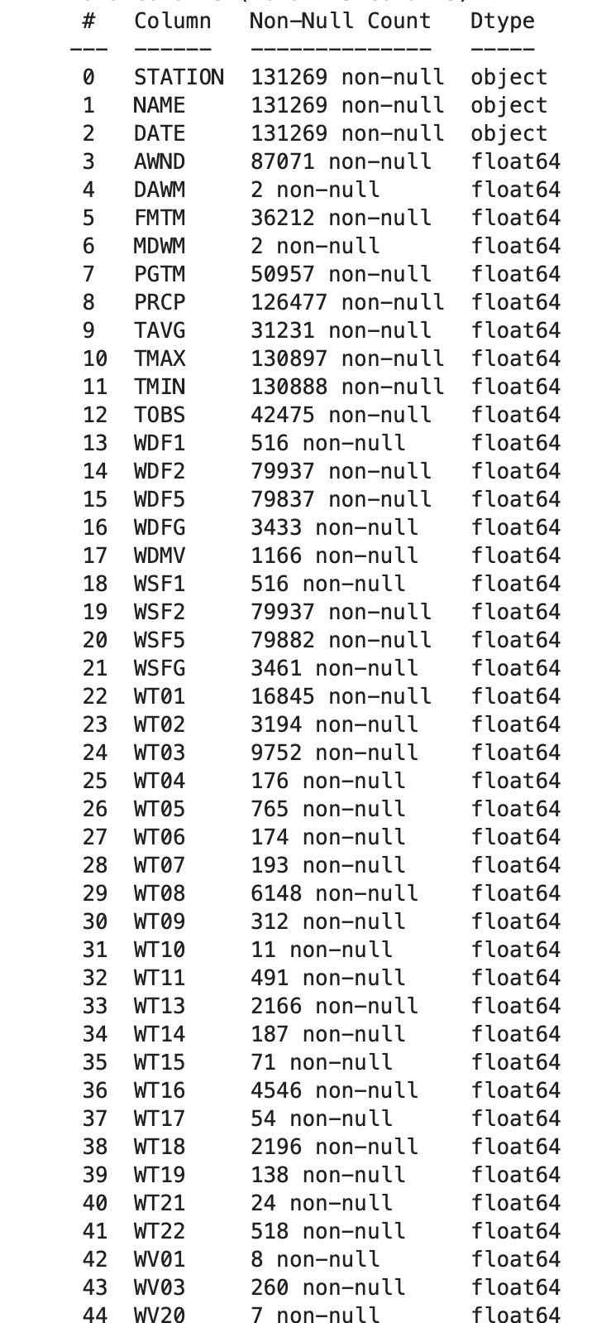
Data Sources (cont.)
Colorado Weather Station Data
Contains 24 years of weather observations from 15 weather stations in the state of Colorado
Source: Directly from NOAA

Slide 7
Initial Exploratory Data Analysis
Remove columns that are not useful from both data sets
Columns removed included columns that were mostly null values and columns that contained identifier information that is not useful to this application
Reformatted certain columns to match the format of the other data set
Example include reformatting the date and latitude/longitude values
Set fields for uncaptured observations to 0

Slide 8
Combining The Data Sets
Combining the wildfire and weather data sets proved to be a challenge
The approach taken was to correlate each wildfire occurrence to the weather data from the nearest weather station for that day
from math import cos, asin, sqrt
def distance(lat1, lon1, lat2, lon2):
p = 0.017453292519943295
hav = 0.5 - cos((lat2-lat1)*p)/2 + cos(lat1*p)*cos(lat2*p) * (1-cos((lon2-lon1)*p)) / 2
return 12742 * asin(sqrt(hav))
def closest(data, v):
return min(data, key=lambda p: distance(v['lat'],v['long'],p['lat'],p['long']))
def get_nearest_station(lat, long):
v = {'lat': lat, 'long': long}
lat_key_list = list(lat_vals.keys())
lat_value_list = list(lat_vals.values())
nearestStationLatLong = closest(stationLatLongList, v)
nearestStation = lat_key_list[lat_value_list.index(nearestStationLatLong['lat'])]
return nearestStation

Slide 9
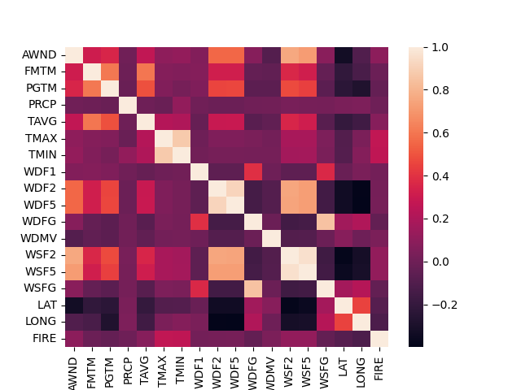
Combining The Data Sets (Cont.)
Whether or not a fire occurred for a certain weather station on a specified day is captured in the ‘FIRE’ column
Initial heatmap assessment indicates that temperature captured has a relatively high correlation to the FIRE indicator

Slide 10
Logistic Regression
A logistic regression model can be used on the weather dataset with the wildfire occurrences to make predictions
x_train, x_test, y_train, y_test = train_test_split(x, y, test_size=0.25, random_state=0)
# Create Logistic Regression model
lr_model = LogisticRegression(solver='liblinear')
# Fit the LR model with data
lr_model.fit(x_train,y_train)
# Create predictions
y_pred=lr_model.predict(x_test)
y_pred

Slide 11
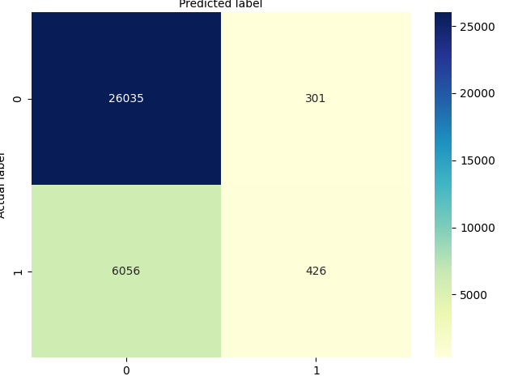
Logistic Regression Metrics
Metric results from Random Forest model
Accuracy: 0.8063
Precision: 0.5860
Recall: 0.0657

Slide 12
Random Forest
A random forest model can be used to make predictions for whether certain weather conditions will result with, or have a higher probability of, a wildfire occurrence
x_train, x_test, y_train, y_test = train_test_split(x, y, test_size=0.25, random_state=0)
# creating a RF classifier
rfClass = RandomForestClassifier(n_estimators = 100)
# Fit the model
rfClass.fit(x_train, y_train)
# Perform predictions for the test data set
y_pred = rfClass.predict(x_test)

Slide 13
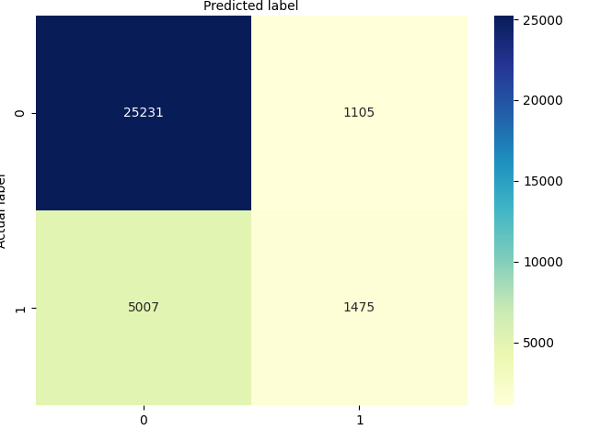
Random Forest Metrics
Metric results from Random Forest model
Accuracy: 0.81239
Precision: 0.56171
Recall: 0.22817
Top contributors to Wildfire occurrences
Max Temperature (0.18)
Min Temperature (0.17)
Average Wind Direction (0.11)
Wind Speed (0.07)
Precipitation (0.06)

Slide 14
Conclusion
Correlation between certain weather conditions and wildfire occurrences can be linked to several key values (temperature, wind direction, wind speed)
The Random Forest Model consistently produced a better accuracy, precision, and recall score than the logistic regression model
Regret: Not having a well-suited weather data set for this purpose
Data collected from various weather stations were lacking

